Slide 1
Image Enhancement using GANs II

Slide 2
Group 7
Submitted By:
Soumya Ranjan Naik
Ansuman Samal
Azazul Haque
Hrushikesh Sahu
Md.Azharuddin
Guided By:
Dr. Sanjay Kumar Patra
Dr. Sangita Pal

Slide 3
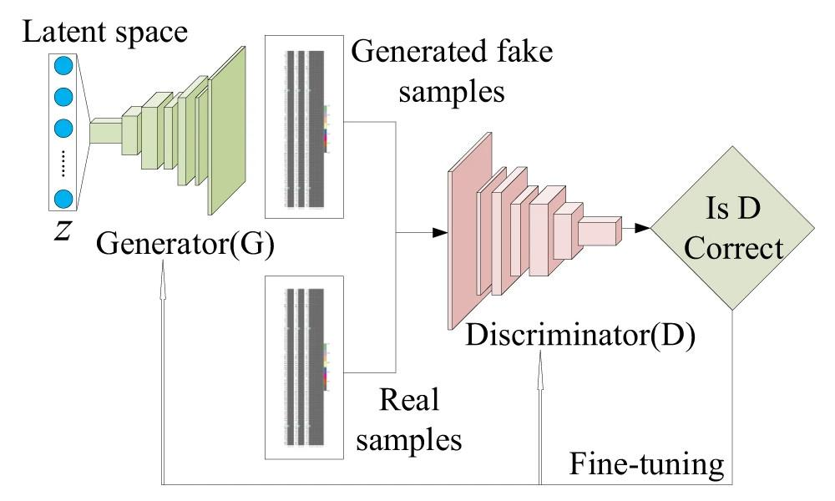
Recap...
Image Source: https://www.nature.com/articles/s41524-020-00352-0

Slide 4
Latent Space
N-dimensional input vector to Generator model.
Each variable is drawn from a Gaussian distribution with a mean of zero and a standard deviation of one.
Generator learns to map points onto the latent space with specific output images. This mapping varies each time the model is trained.
Points in the latent space can be kept and used in simple vector arithmetic to create new points in the latent space.
0 | -0.5 | 0.456 | 1 | -0.3
1-D Latent vector example

Slide 5
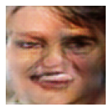
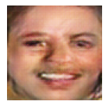
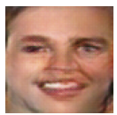
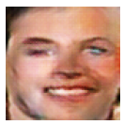
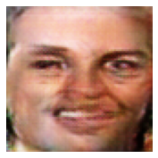
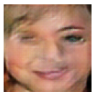
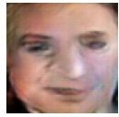
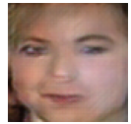
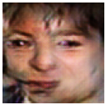
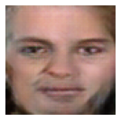
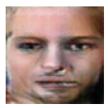
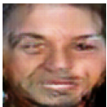
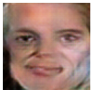
Arithmetic
Teeth showing Woman
Normal Woman
Normal Man
Image Source: Our Laptop

Slide 6
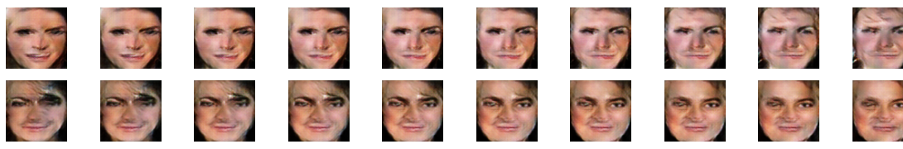
Transition
Image Source: Our Laptop

Slide 7
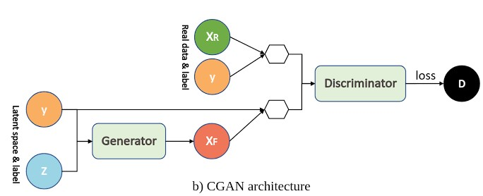
Conditional GAN (cGAN)
Problem it overcomes: No control over output
Additional information is provided to Generator and Discriminator that is correlated with the input images, such as class labels.
By conditioning the model on additional information it is possible to direct the data generation process.
Image Source: google.com

Slide 8
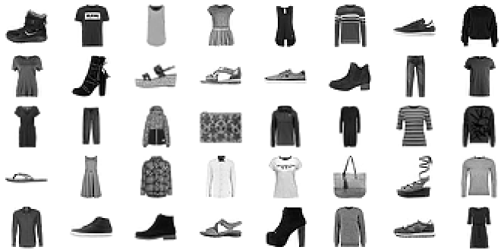
Fashion MNIST
Image Source: Our Laptop

Slide 9
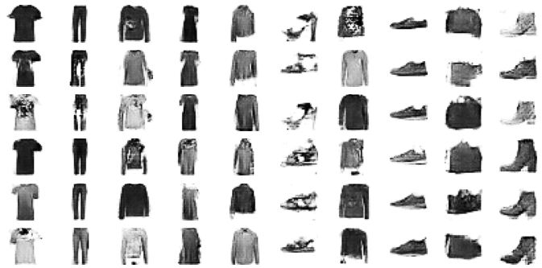
Our cGAN Output
Image Source: Our Laptop

Slide 10
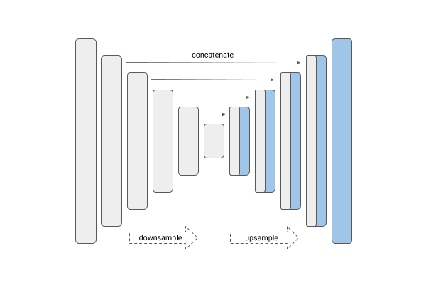
U-Net Architecture
A replacement of common Encoder-Decoder model
It contains links or skip-connections between layers of the same size in the encoder and the decoder.
This gives the generator a means to circumvent the bottleneck for information.
Image Source: kaggle.com

Slide 11
PatchGAN Architecture
Not actually GAN, rather a Discriminator model.
Introduced in paper “Image-to-Image Translation with Conditional Adversarial Networks, 2016” .
It is designed to classify patches of an input image as real or fake, rather than the entire image.
The output is a single feature map of real/fake predictions that can be averaged to give single score.
A patch size of 70 × 70 was found to be effective across a range of image-to-image translation tasks.

Slide 12
Pix2Pix GAN
Pix2Pix stands for Pixel to Pixel
It is an approach to train deep CNN for image-to-image translation.
It is a type of cGAN where the condition is the input image itself.
The U-Net architecture is prefered for generator.
The PatchGAN architecture is preferred for discriminator.

Slide 13
References
Alec Radford, Luke Metz & Soumith Chintala, “Unsupervised Representation Learning with Deep Convolutional Generative Adversarial Networks”
Shuo Yang, Ping Luo, Chen Change Loy & Xiaoou Tang, “From Facial Parts Responses to Face Detection: A Deep Learning Approach”
Mehdi Mirza & Simon Osindero, “Conditional Generative Adversarial Nets”
Phillip Isola, Jun-Yan Zhu, Tinghui Zhou and Alexei A. Efros, “Image-to-Image Translation with Conditional Adversarial Networks”
Generative Adversarial Networks with Python by Jason Brownlee

Slide 14
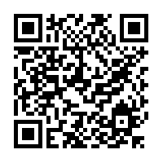
Thanks!
Any questions?
http://bit.ly/igit36_group7

